Slide 1
Box Platform Developer Workshop
Jonathan LeBlanc
Director of Developer Advocacy, Box
Twitter: @jcleblanc
Github: https://github.com/jcleblanc

Slide 2
Service Accounts

Slide 3
What is a Service Account

Slide 4

Service Account Details
A user account that represents your application in an enterprise.
Can only be accessed programmatically.
Has its own file storage.
Generated automatically with a new JWT application.
Access Rights
By default, a service account only has access to its own data store.
Access to app users / managed users has to be explicitly enabled and requested.

Slide 5
Service Account Architecture

Slide 6


Where to Store User and Application Data
Service Account
User Account
Maintain all user an application
data within the service account.
Users will be collaborated in
on content.
User specific data is maintained
in the individual user account. All
data access requests are made on
behalf of the user.

Slide 7

Storing Data in the Service Account (Overview)
Benefits
Improved data security due to tight controls over data location and sharing
Data retention and migration improves following customer deletion, as the user collaboration is simply removed.
Concerns
Architecture complexity increases as a separate user folder structure needs to be maintained in the service account.
Single point of failure.

Slide 8

Storing Data in the User Account (Overview)
Benefits
Data is retained and owned by each user.
Simple repeatable architecture on each user account.
Concerns
Data retention after customer deletion requires data migration or loss.
App has no control over data integrity.

Slide 9
Users and Permissions

Slide 10



User Access Levels for a Service Account
No User Access
App Users
All Users
Service account can only
access its own content
Service account can access
its own content and content for
any app users it creates
Service account can access
its own content, app user
content, as well as content of any
users in the enterprise

Slide 11
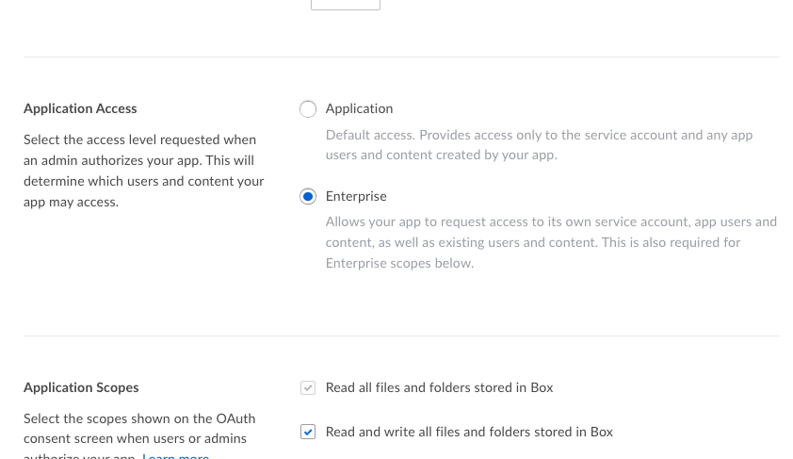
Application Access
Application: Only access data and users within the JWT app.
Enterprise: Access data and users within the app as well as the entire enterprise that the app is a part of.

Slide 12
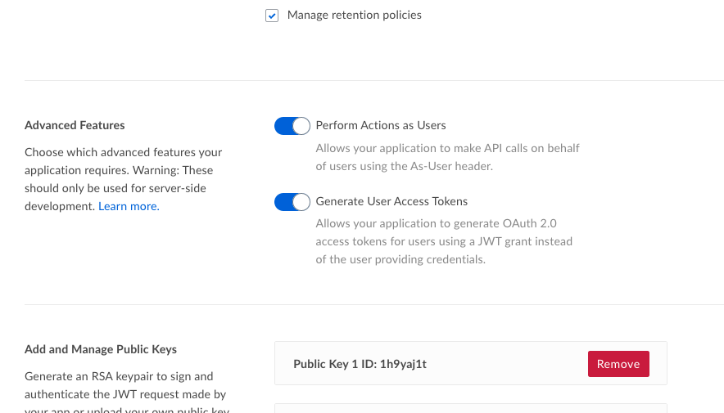
Advanced Features
Perform actions as users: Use an As-User header with each request to act on behalf of a user. Access token passed is for service account.
Generate user access tokens: Create an access token scoped to a user account and use that token for each request.

Slide 13
Setting User Access for the Service Account
Settings to use to get the desired level of user access for a service account
User Access | Application Access | Advanced Features
No User Access | Application | None set
App Users Only | Application | One or both set
App and Managed Users | Enterprise | One or both set

Slide 14
Links and Code Samples

Slide 15
Code Samples
Service Accounts
Uploading file to service account: https://github.com/jcleblanc/box-workshops/blob/master/service-accounts/service-account-upload-sa.js
Uploading file to user account using As-User header: https://github.com/jcleblanc/box-workshops/blob/master/service-accounts/service-account-upload-asuser.js
Uploading file to user account using user access token: https://github.com/jcleblanc/box-workshops/blob/master/service-accounts/service-account-upload-usertoken.js

